Slide 1
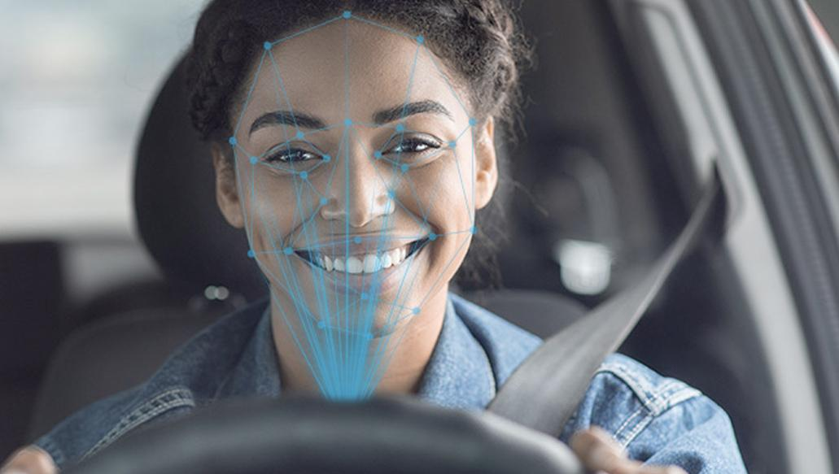
Drowsiness Detection System with Emotion Analysis for Improved Vehicle Experience
Group 32
Rahul Bharadwaj
Amogh Kori Akshay Singh

Slide 2
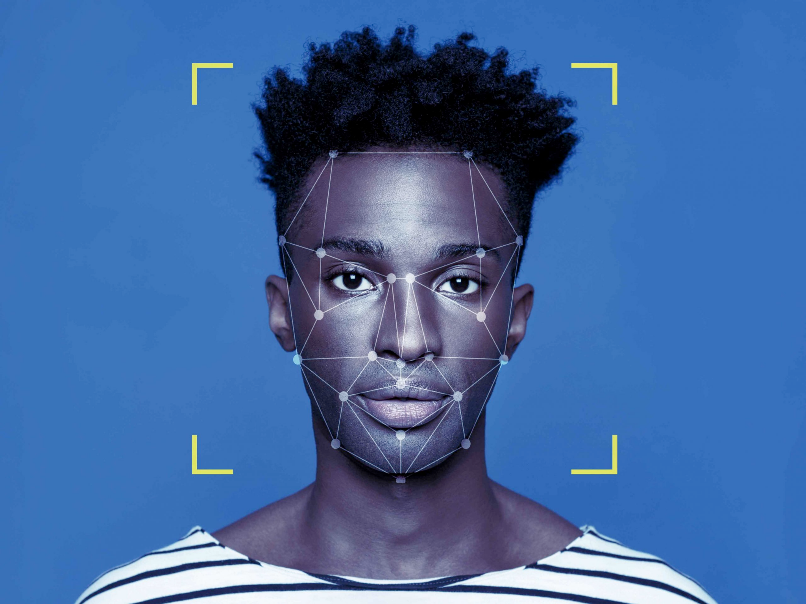
Problem Statement
The primary goal of this project is to identify whether the driver is drowsy or not. And, In addition to that we are detecting facial emotions too

Slide 3
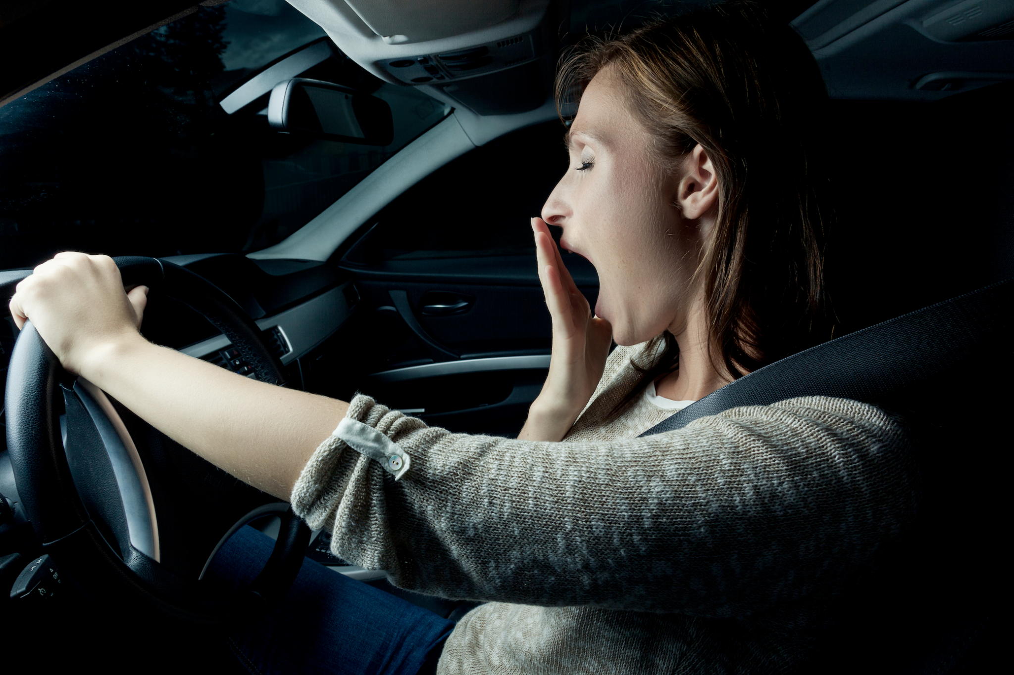
Why is this important?
Drunkenness or exhaustion is a leading cause of car accidents, with severe implications for road safety.
The National Highway Traffic Safety Administration indicated that around 150 individuals are murdered in the United States every year due to driver tiredness. 71,000 harmed and $12.5 billion in misfortunes.

Slide 4
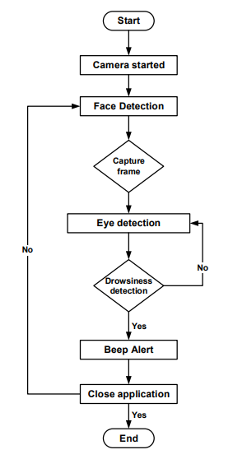
Workflow for Drowsiness

Slide 5
Drowsiness Detection
Libraries Used :
SciPy
Imutils
Dlib
OpenCV-Python

Slide 6
OpenCv - is an open source computer vision and machine learning software library.OpenCV was built to provide a common infrastructure for computer vision applications and to accelerate the use of machine perception in the commercial products.
Imutils package - Series of computer vision and image processing functions to make working with OpenCV easier.
SciPy package - we can compute the Euclidean distance between facial landmarks points in the eye aspect ratio calculation.
Dlib - It‘s a landmark’s facial detector with pre-trained models, the dlib is used to estimate the location of 68 coordinates (x, y) that map the facial points on a person’s face like image given here.

Slide 7
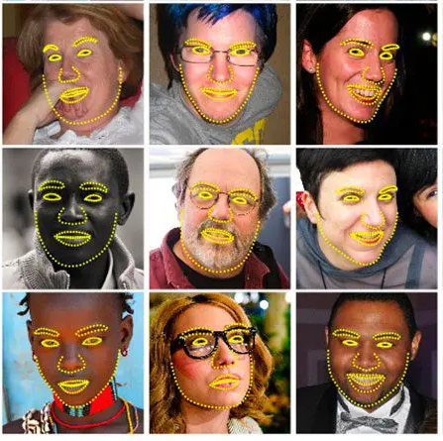
Face Detection
dlib.shape_predictor()
Shape predictors, also called landmark predictors, are used to predict key (x, y)-coordinates of a given “shape”.
The most common, well-known shape predictor is dlib’s facial landmark predictor which is used to localize individual facial structures, including the - Eyes, Eyebrows, Nose, Lips/mouth, Jawline.

Slide 8
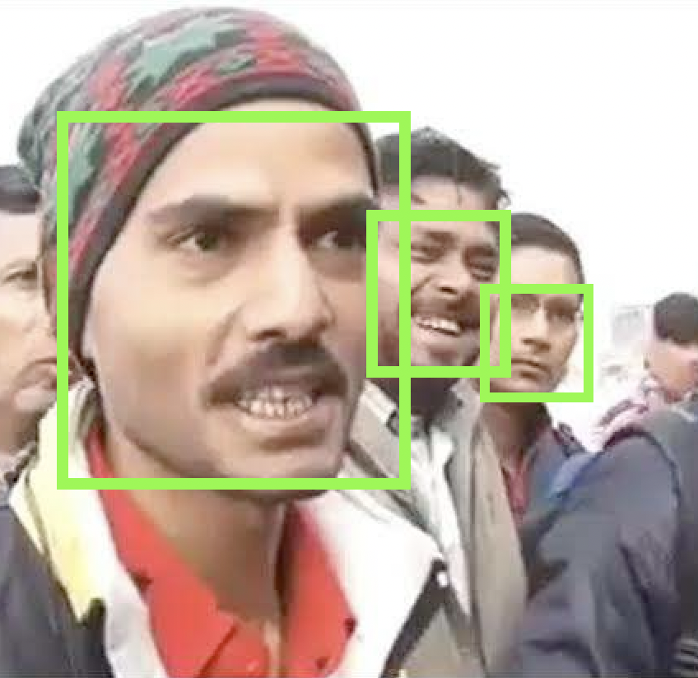
Capture Frame
get_frontal_face_detector()
The get_frontal_face_detector function does not accept any parameters. A call to it returns the pre-trained HOG + Linear SVM face detector included in the dlib library.
Dlib’s HOG + Linear SVM face detector is fast and efficient. By nature of how the Histogram of Oriented Gradients (HOG) descriptor works, it is not invariant to changes in rotation and viewing angle.

Slide 9
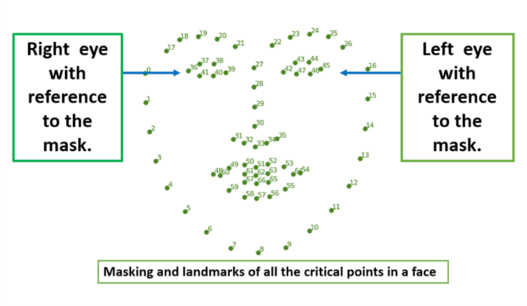
Eye Detection
RightEAR
LeftEAR

Slide 10
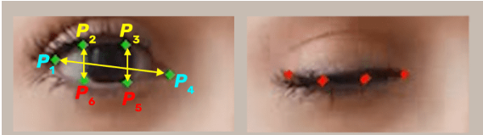
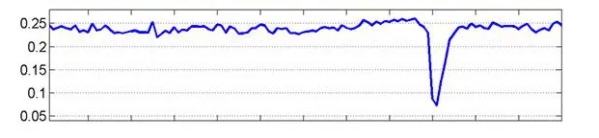
Eye aspect ratio (EAR)
Reference: https://pyimagesearch.com/2017/05/08/drowsiness-detection-opencv/

Slide 11
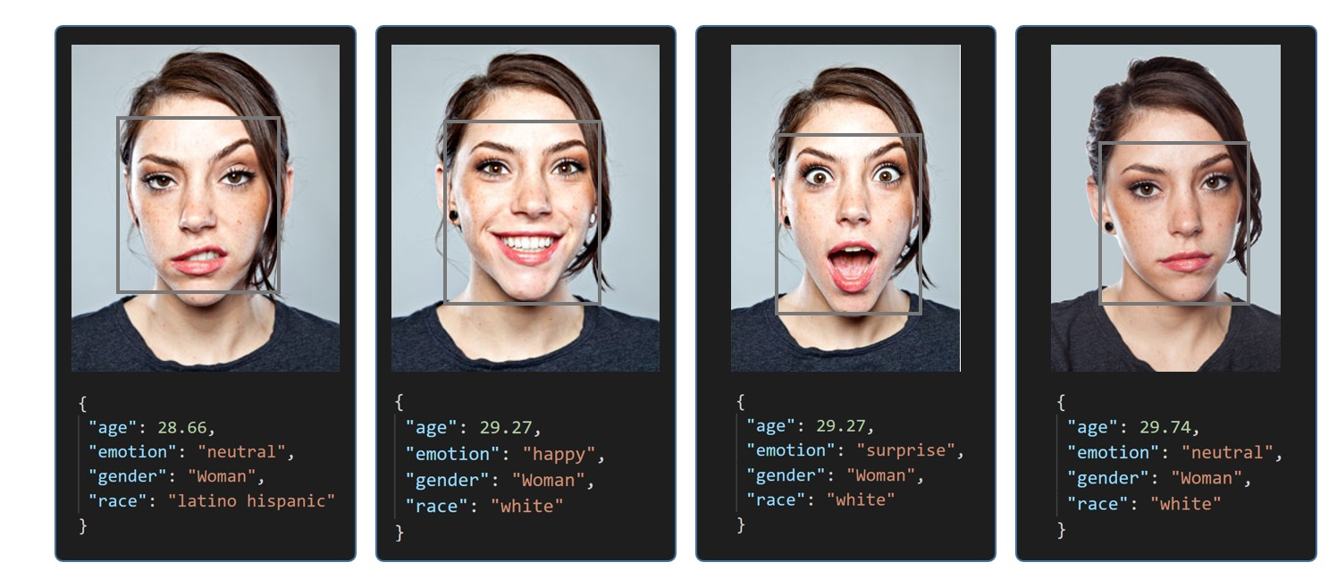
Emotion Detection
Libraries Used
Deepface
Deepface is a lightweight face recognition and facial attribute analysis (age, gender, emotion and race) framework for python. It is a hybrid face recognition framework wrapping state-of-the-art models: VGG-Face, Google FaceNet, OpenFace, Facebook DeepFace, DeepID, ArcFace, Dlib and SFace.
Deepface also comes with a strong facial attribute analysis module including age, gender, facial expression (including angry, fear, neutral, sad, disgust, happy and surprise) and race (including asian, white, middle eastern, indian, latino and black) predictions.

Slide 12
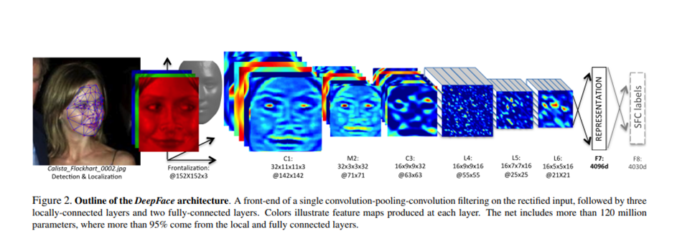
Deepface Architecture
Reference - https://www.cs.toronto.edu/~ranzato/publications/taigman_cvpr14.pdf

Slide 13
Haar Cascade Classifier
A modern implementation of the Classifier Cascade face detection algorithm is provided in the OpenCV library. This is a C++ computer vision library that provides a python interface. The benefit of this implementation is that it provides pre-trained face detection models, and provides an interface to train a model on your own dataset.
The nice thing about haar feature-based cascade classifiers is that you can make a classifier of any object you want, OpenCV already provided some classifier parameters to you, so you don’t have to collect any data to train on it.
It is super fast to work with and like the simple CNN, it extracts a lot of features from images. The best features are then selected via Adaboost. This reduces the original 160000+ features to 6000 features. But applying all these features in a sliding window will still take a lot of time. So they introduced a Cascade of Classifiers, where the features are grouped. If a window fails at the first stage, these remaining features in that cascade are not processed. If it passes then the next feature is tested and the same procedure is repeated. If a window can pass all the features then it is classified as a face region.

Slide 14
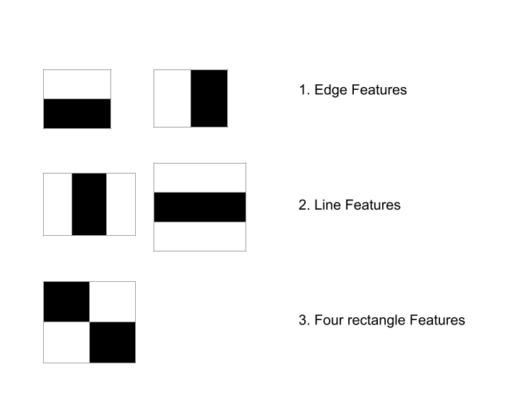
What are Haar Features like?
Haar features are the relevant features for face detection. It was proposed by Alfred Haar in 1909. They are like convolutional kernels. There are various types of haar like features but the most dominant features used are :
2 Rectangular Haar features
3 Rectangular Haar features
4 Rectangular Haar features

Slide 15
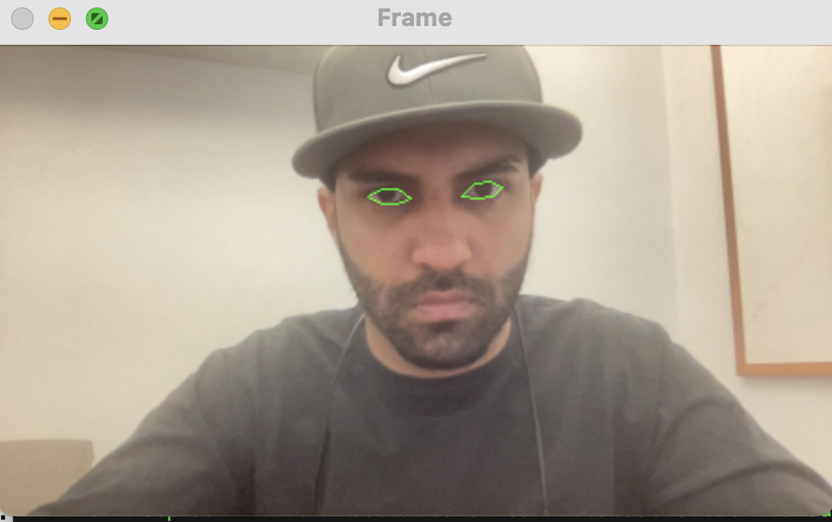
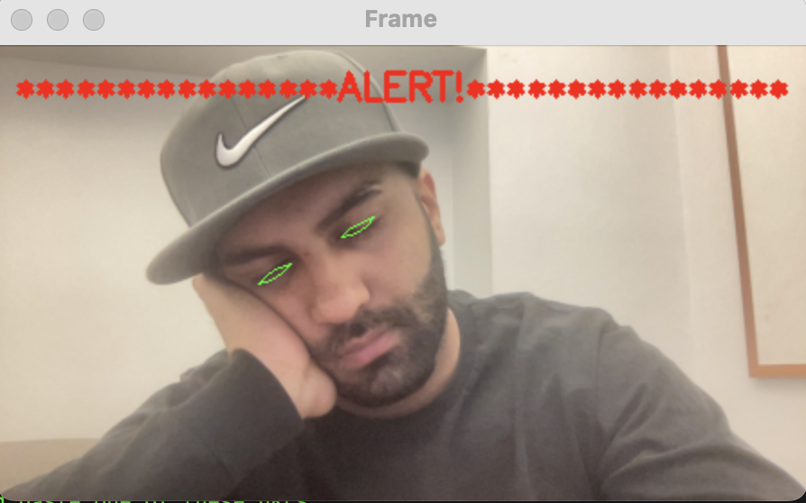
Demonstration - Drowsiness Detection
When the user is attentive VS When the user is sleepy

Slide 16
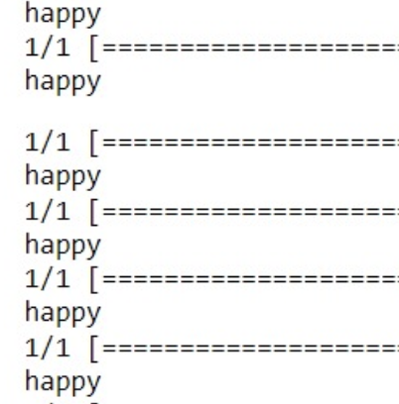
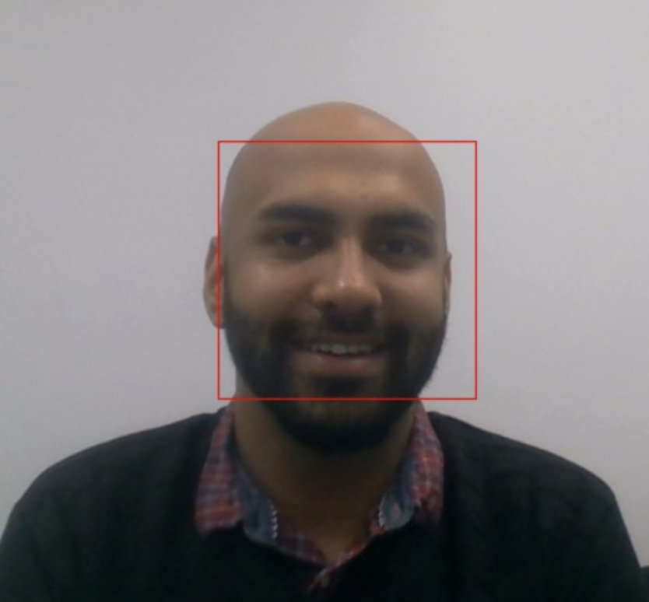
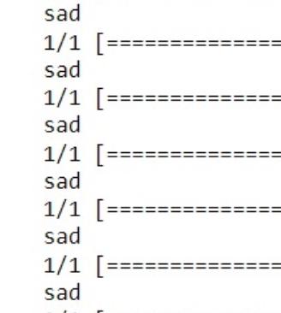
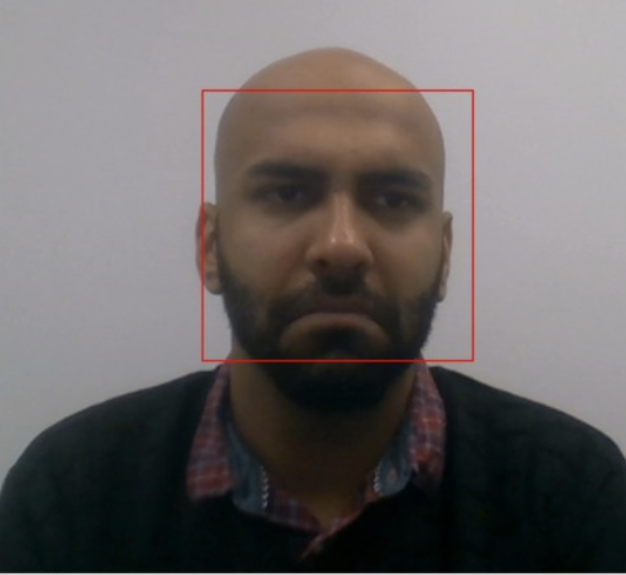
Demonstration - Emotion Detection
Me when I saw ML assignment number 1
Me when I saw ML assignment number 3

Slide 17
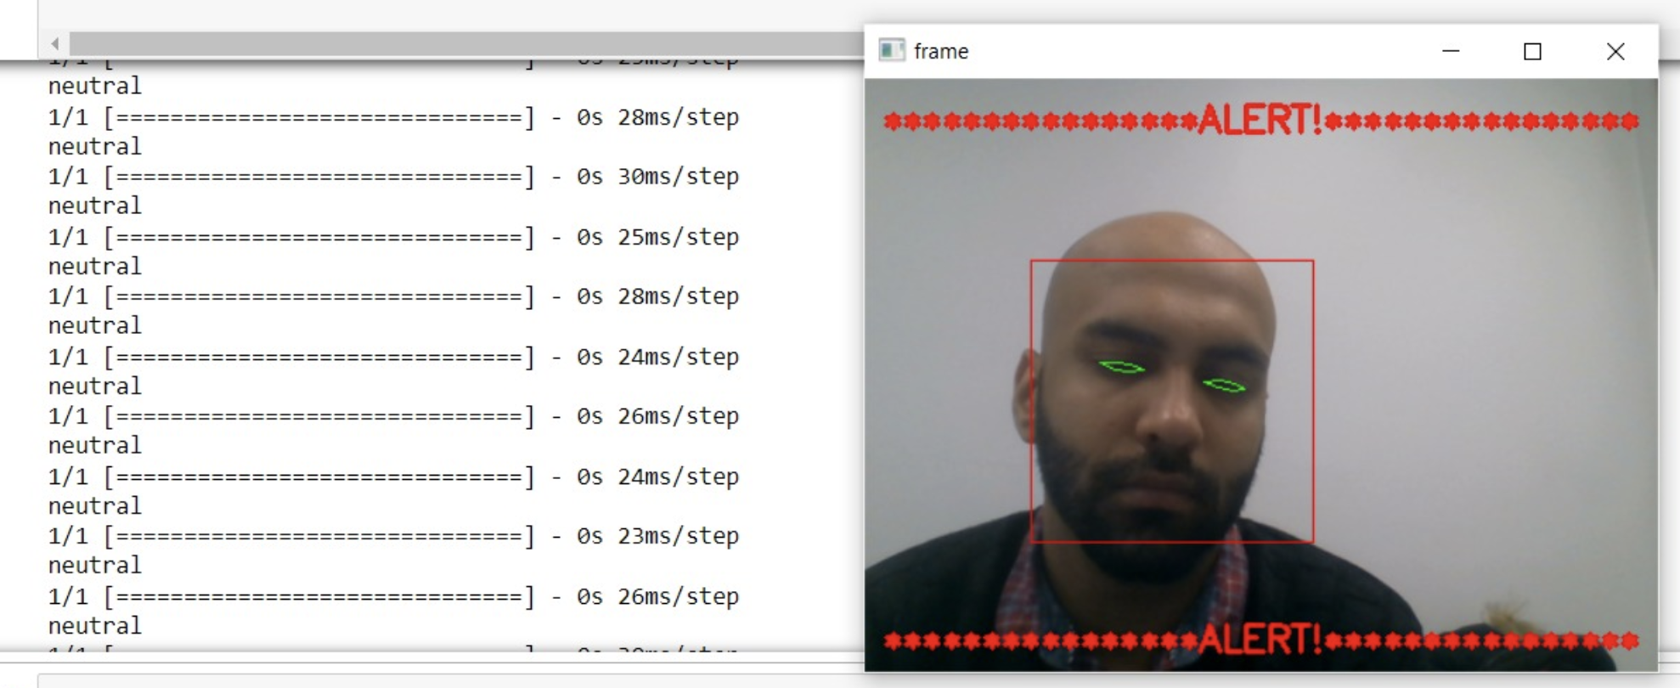
Combination of Both

Slide 18
Live Demonstration

Slide 19
Future Scope
Personalized in-cabin experience
By predicting emotion of the driver, we can use this information to sync certain in car settings such as music, temperature, lights etc to match the emotion. For example - if I’m a user and I’m feeling ecstatic that day, I would love if my car would automatically play me some EDM or if I am feeling angry at something, my car could play me some soothing ocean sounds to calm me down.
Medical Diagnosis
A distressed face coupled with voice analysis could be used to alert the user as well as close family members in case of an extreme emotional state.

Slide 20
Conclusion
Dlib’s HOG + Linear SVM face detector is fast and efficient. By nature of how the Histogram of Oriented Gradients (HOG) descriptor works, it is not invariant to changes in rotation and viewing angle.
We could have used CNN for this which would have given us better face detection even in the case of tilted face, but that would have come at the expense of a slower model, but since we are implementing this model for a vehicle, we are assuming that people will not be driving their cars with a tilted face, and hence we thought HOG + Linear SVM would be a better option.
The use of CNN from the DeepFace library for the emotion detection helped us understand the use of Pre-Trained models which is a newly developed methodology.
The main idea of the project is to examine and implement both the traditional methods and the newly developed Methods like CNN to ultimately develop an ‘EFFICIENT’ model which is both Accurate and power efficient.

Slide 21
Thank You

Slide 22
Any Questions?

